Slide 1

Alarm System
Fedy Haj Ali
Daniela Koreta
Real-Time Embedded System
A.A. 2020-2021

Slide 2
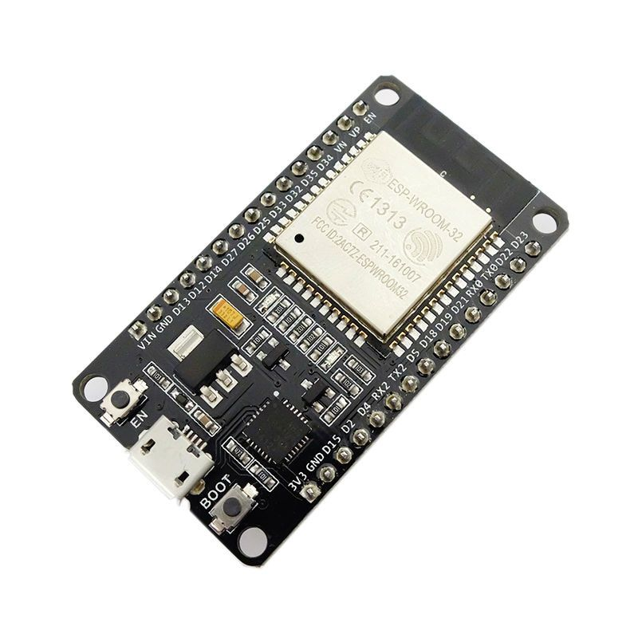






tools

Slide 3
hardware components
esp32
breadboard
4 buttons
5 leds
jumper wires
IR receiver sensor
HC-SR04 ultrasonic sensor
buzzer
display LCD 16x2
IR remote control

Slide 4
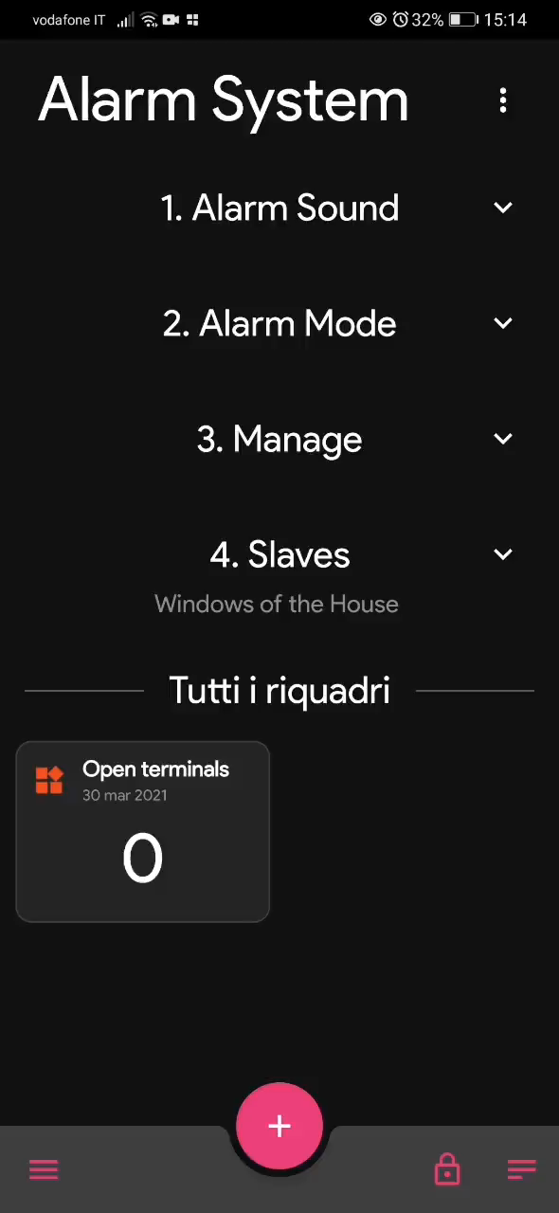
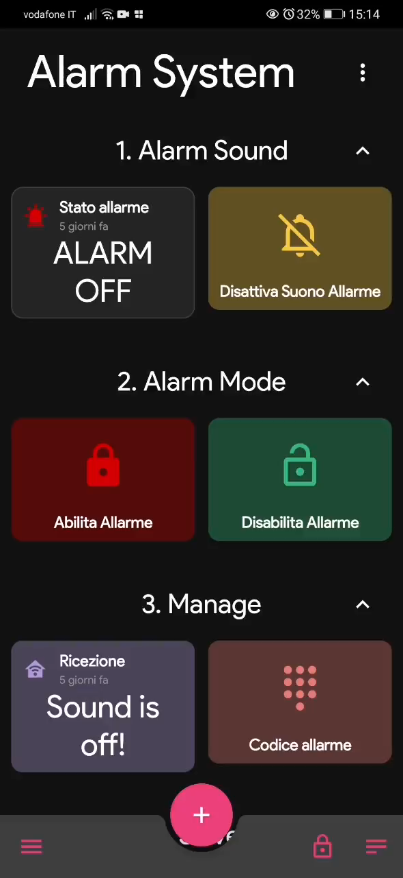
MQTT

